Slide 1
AGILE METHODOLOGIES
Team members-
Rochita Bagchi
Haya Fatima
Sandeep Chand Ranjan
Satish

Slide 2
AGILE methodology is a practice that promotes continuous iteration of development and testing throughout the software development lifecycle of the project.
The agile software development emphasizes on four core values.
1) Individual and team interactions over processes and tools
2) Working software over comprehensive documentation
3) Customer collaboration over contract negotiation
4) Responding to change over following a plan

Slide 3
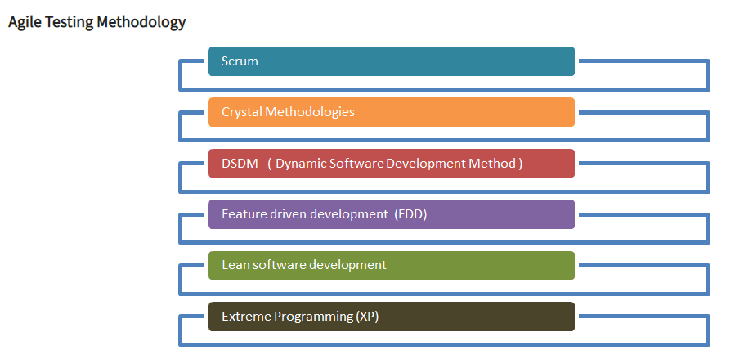
Agile Testing Methodology

Slide 4
SCRUM
SCRUM is an agile development method which concentrates specifically on how to manage tasks within a team-based development environment.
Basically, Scrum is derived from activity that occurs during a rugby match. Scrum believes in empowering the development team and advocates working in small teams (say- 7 to 9 members).
It consists of three roles, and their responsibilities are explained as follows:
Scrum Master
Master is responsible for setting up the team, sprint meeting and removes obstacles to progress
Product owner
The Product Owner creates product backlog, prioritizes the backlog and is responsible for the delivery of the functionality at each iteration
Scrum Team
Team manages its own work and organizes the work to complete the sprint or cycle

Slide 5
Extreme Programming
Extreme Programming technique is very helpful when there is constantly changing demands or requirements from the customers or when they are not sure about the functionality of the system. It advocates frequent "releases" of the product in short development cycles, which inherently improves the productivity of the system and also introduces a checkpoint where any customer requirements can be easily implemented. The XP develops software keeping customer in the target.

Slide 6
Lean Software Development
Lean software development method is based on the principle "Just in time production". It aims at increasing speed of software development and decreasing cost. Lean development can be summarized in seven steps.
Eliminating Waste
Amplifying learning
Defer commitment (deciding as late as possible)
Early delivery
Empowering the team
Building Integrity
Optimize the whole

Slide 7
Feature Driven Development

